Slide 1
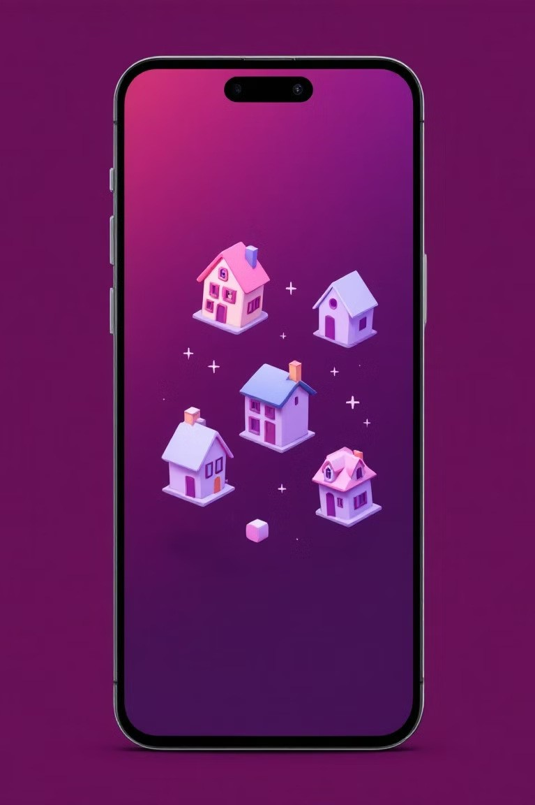
House Rent App: Revolutionizing
Property Search
Team name : NM2024TMID10624
S. Narmada (au211521244035)
M. Nithya Sree (au211521244036)
H. Priyadharshini (au211521244041)
S. Yuvashri (au211521244062)

Slide 2
Introduction
Introducing our innovative House Rent App, a comprehensive solution for property seekers and landlords. This cutting-edge platform streamlines the rental process, offering a user-friendly interface and powerful features to connect tenants with their ideal homes.

Slide 3
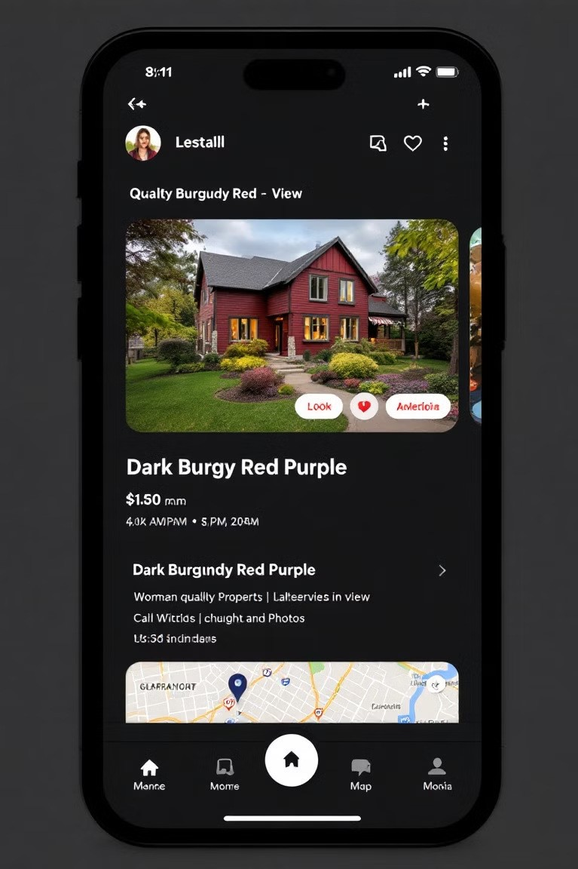
Feature-Rich Property Listings
1
Comprehensive Details
Each listing includes high-resolution photos, detailed descriptions, and virtual tours for immersive exploration.
2
Wide range of hotels
There are wide range of hotels, resorts are available in our app.
3
Real-Time Availability
Listings are updated in real-time, ensuring users access the most current rental opportunities.

Slide 4
Advanced Search and Filtering
Customizable Filters
Saved Searches
Intelligent Recommendations
Users can refine searches by location, price range, property type, and amenities.
Personalized search preferences can be saved for quick access to relevant listings.
Machine learning algorithms suggest properties based on user behavior and preferences.

Slide 5

Seamless Communication
1
In-App Messaging
Secure, real-time messaging system facilitates direct communication between tenants and landlords.
2
Appointment Scheduling
Integrated calendar allows easy booking of property viewings and management of appointments.
3
Document Sharing
Secure platform for exchanging rental agreements, references, and other necessary documentation.

Slide 6
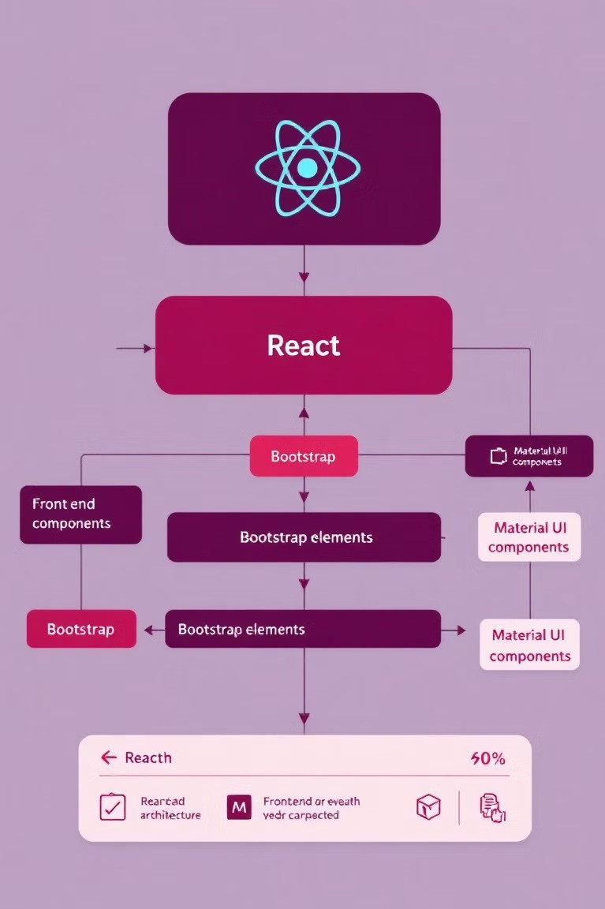

Frontend Architecture
React.js Framework
Utilizes React for building dynamic and responsive user interfaces with reusable components.
1
Bootstrap & Material UI
Implements Bootstrap and Material UI for consistent, modern design across all devices.
2
A ios Integration
Employs Axios library for efficient API calls and seamless backend communication.
3

Slide 7

Backend Infrastructure
E press.js Server
Robust Express.js framework handles server-side logic and RESTful API endpoints.
MongoDB Database
Utilizes MongoDB for flexible, scalable storage of user profiles and property data.
RESTful API Design
Implements RESTful architecture for standardized, efficient client- server communication.
Real-Time Updates
Integrates WebSocket technology for instant notifications and live data synchronization.

Slide 8

Security and Authentication
Encrypted Data Transfer
SSL/TLS encryption ensures secure transmission of sensitive user information.
JWT Authentication
Implements JSON Web Tokens for secure, stateless authentication of users.
Two-Factor Authentication
Optional 2FA adds an extra layer of security for user accounts.

Slide 9
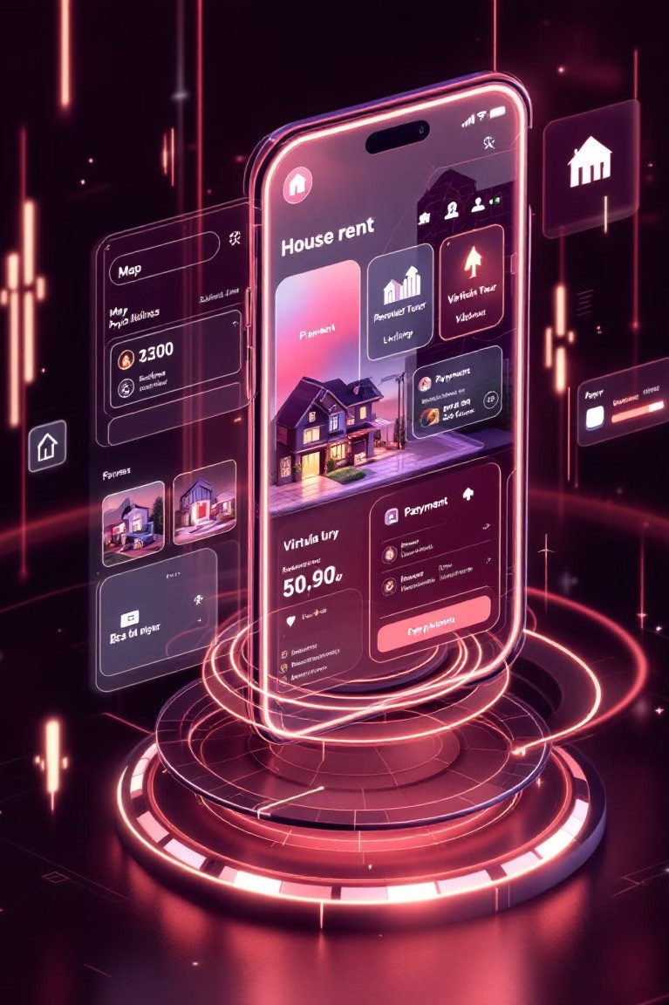
Future Enhancements
AI-Powered Matching
Virtual Reality Tours
Blockchain Integration
Smart Contract Leases
IoT Home Integration
Augmented Reality Furniture Placement

Slide 10
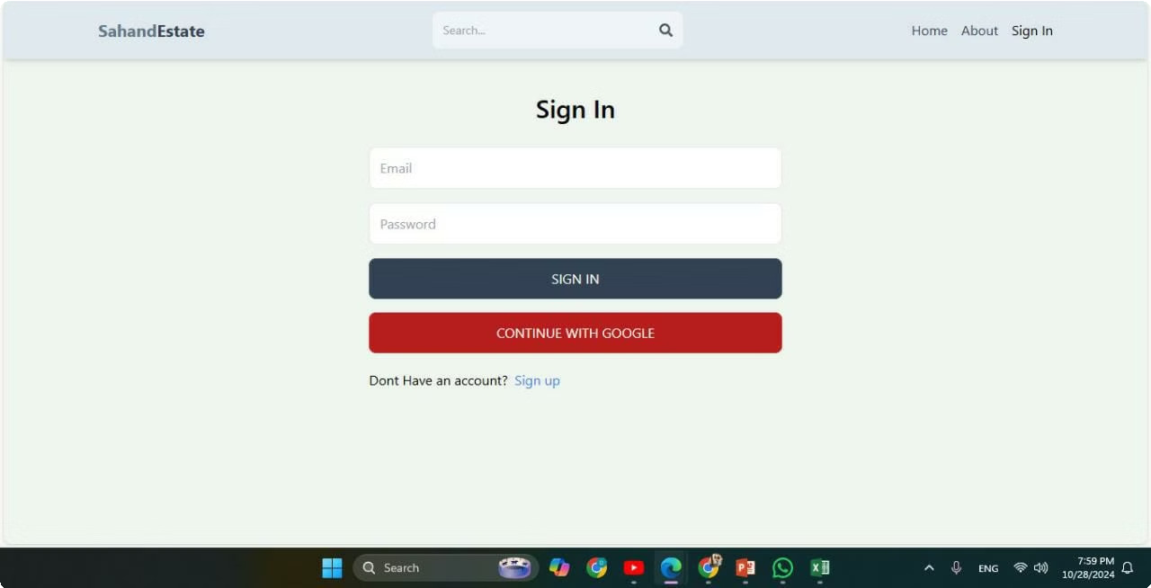
House rental application

Slide 11
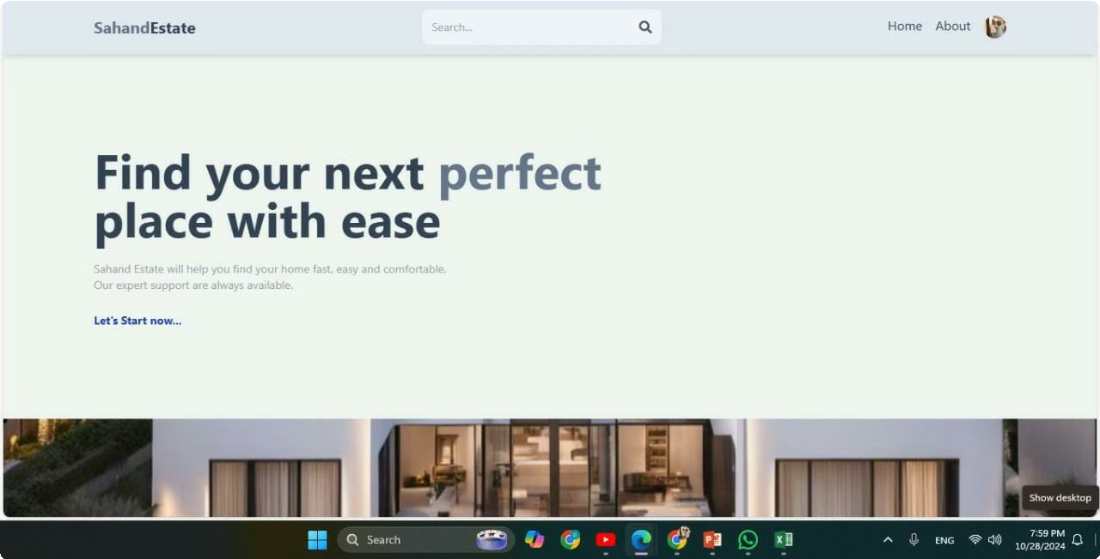

Slide 12
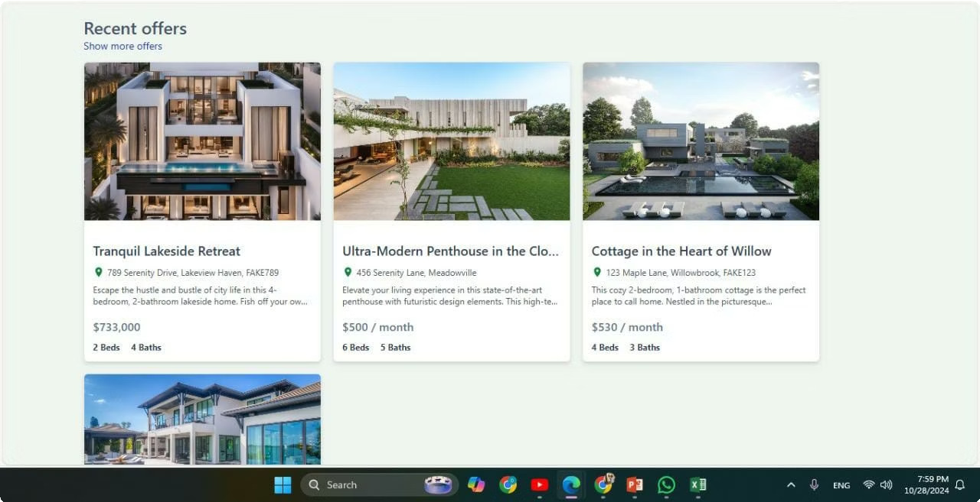

Slide 13
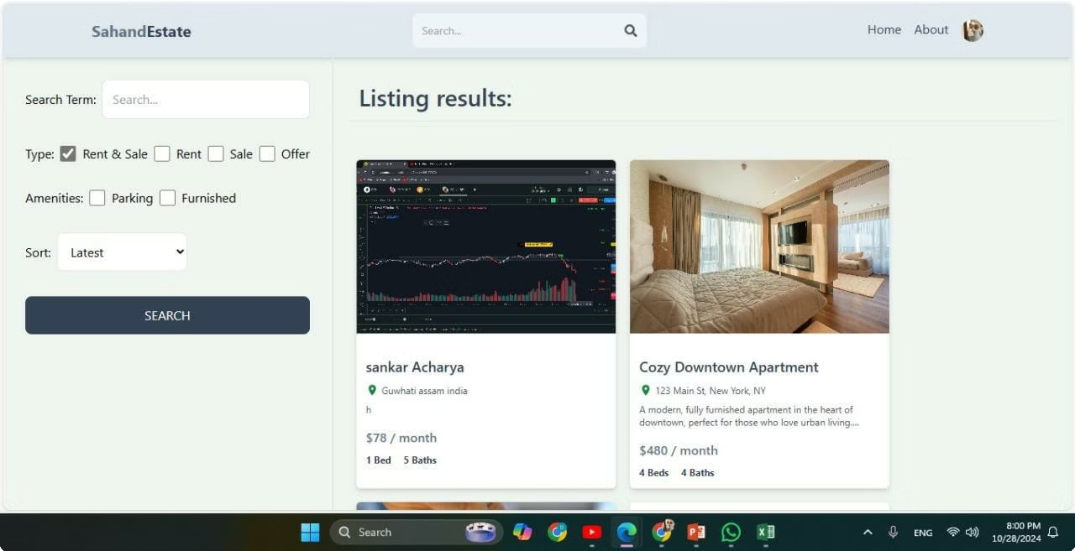

Slide 14
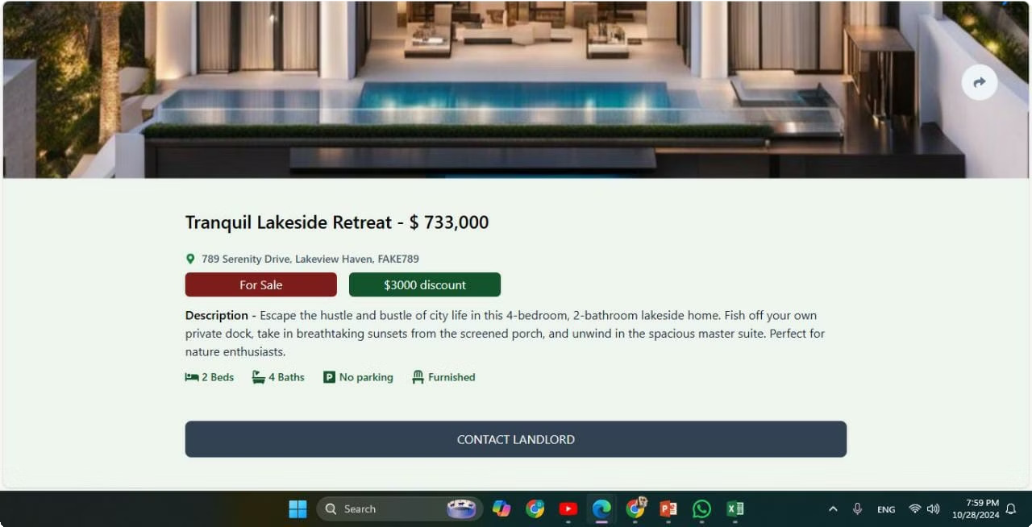

Slide 15
Conclusion
In conclusion, our house rent app provides a comprehensive solution for renters and property owners, ensuring a smooth and secure rental experience. With its MERN-based architecture, the app offers a seamless interface powered by React, Express, and MongoDB, allowing for real-time property browsing, secure bookings, and efficient management. Users benefit from intuitive features like search filters, messaging, and admin oversight, creating a safe and user-friendly environment. This app streamlines the rental process, making it convenient, efficient, and reliable for all parties involved.

Slide 16
Thank you

